Slide 1
Business Intelligence Assistant Based on Strands Agents SDK
Intern AI solutions EXPO
Runpeng XIA
Solutions Architect Intern
AWS GCR SSO

Slide 2
Agenda
Project Overview
Technologies
System architecture
Demo

Slide 3
Project Overview
Goal
making data analysis faster, easier, and more accessible
What it is
A smart business intelligence assistant that helps companies understand and analyze their data through simple, natural language conversations.
Without needing technical skills, users can ask questions and receive clear, actionable insights in real time.
The assistant works with various types of data (structured/unstructured) and ensures that sensitive information is masked securely.
Impact
The flexible and secure design allows it to adapt seamlessly to the diverse needs of our customers in various industries

Slide 4
Technologies
LLM: mainly Claude 3.7 Sonnet, all LLMs on Amazon Bedrock
Agent: Strands Agents SDK
Tool Integration: Model Context Protocol
Knowledge base: Amazon Bedrock Knowledge Bases
Database: Amazon Redshift Serverless
Responsible AI: Amazon Bedrock Guardrails

Slide 5
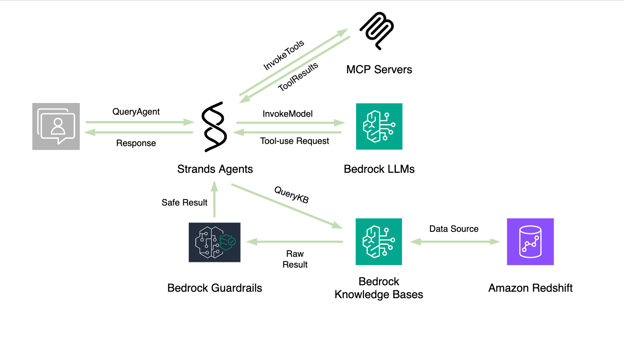
System Architecture

Slide 6
Demo

Slide 7
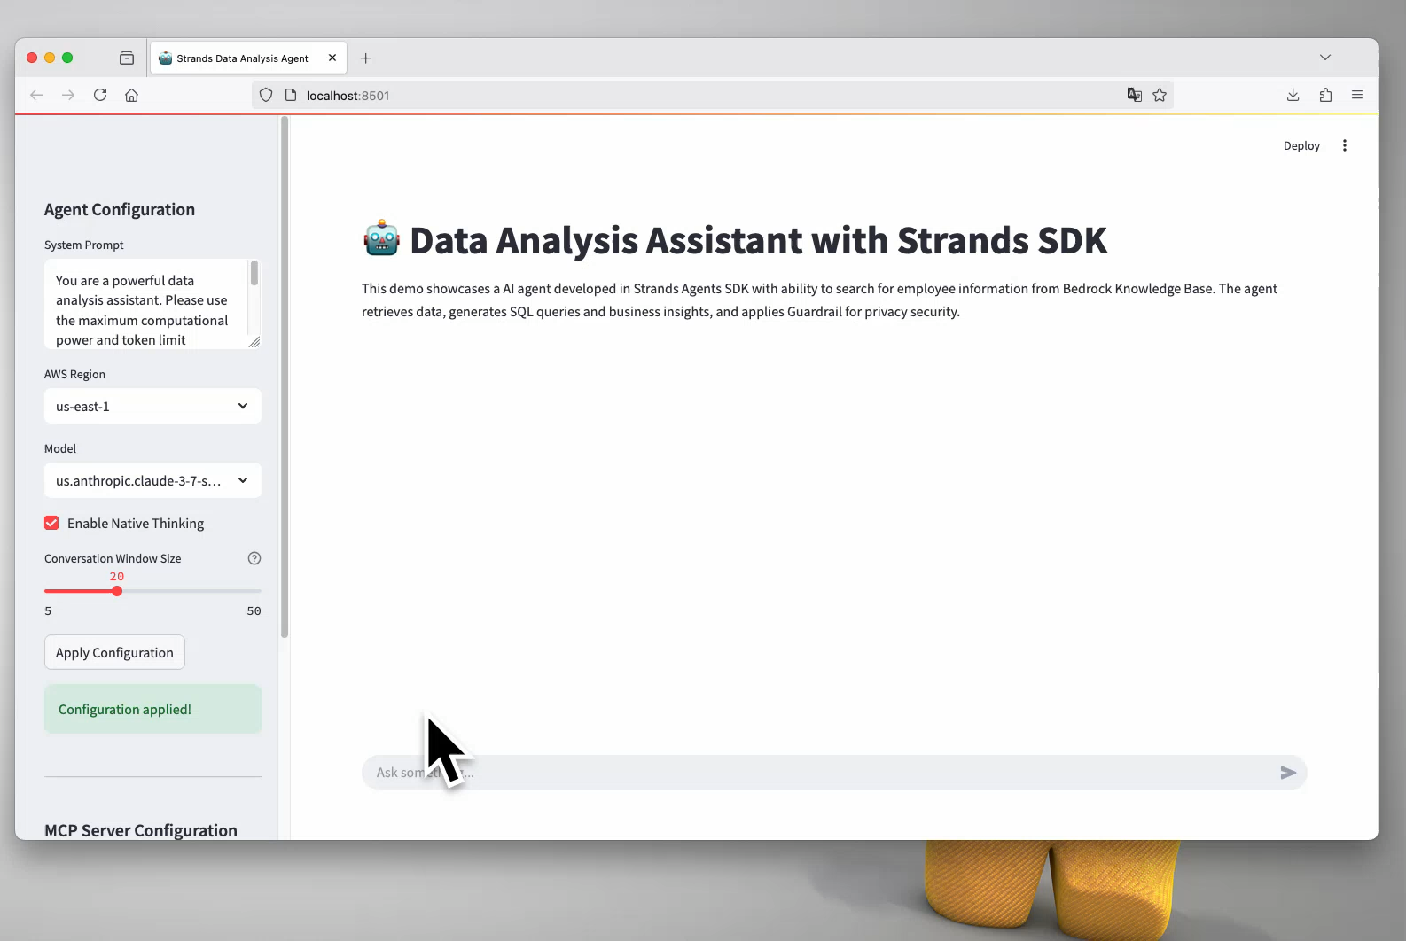

Slide 8
Runpeng XIA
runpeng@amazon.com

